Slide 1
Thyatira
Revelation 2:18-29
Wallace, Steven J. www.revelationandcreation.com

Slide 2
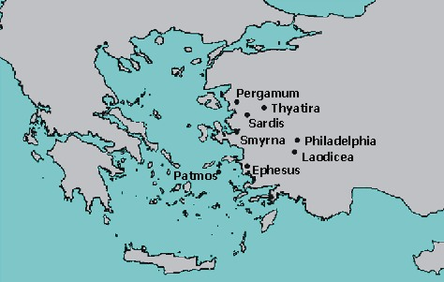
Thyatira

Slide 3
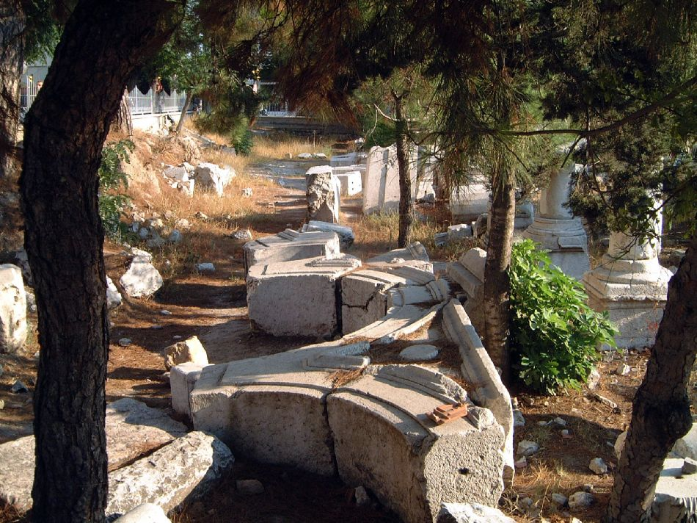
Thyatira
Thyatira was situated in a fertile valley through which trade routes passed. Although damaged by an earthquake during the reign of Augustus, Thyatira was rebuilt with Roman help.
(courtesy of www.holylandphotos.org)
Thyatira (modern Akhisar) has popualtion of ~ 74,000

Slide 4
Thyatira
“Thyatira (modern Akhisar) was a city in the province of Asia, on the boundary of Lydia and Mysia. Thyatira has no illustrious history, and is scarcely mentioned by ancient writers. . .”
http://www.inspirationsbyswain.com/thyatira.htm

Slide 5
The Church at Thyatira
The longest of the letters written to the least known and least important of the cities
Lydia (Acts 16:14)

Slide 6
The Church at Thyatira
Salutation (2:18)
  Not only “Son of Man,” but also “Son of God” (1:13)
  Eyes like a flame
  Feet like fine brass

Slide 7
The Church at Thyatira
Divine Praise (2:19)
  Last works are greater than first
  Love what Ephesus lost
  Service an expression of their love
  (Heb. 6:10)
  Faith was genuine/active (Jas. 2:17)
  Patience, “knowing that the testing of your faith produces patience. But let patience have its perfect work, that you may be perfect and complete, lacking nothing” (Jas. 1:3)

Slide 8
The Church at Thyatira
Divine Protest (2:20)
  Allows Jezebel to teach and seduce
  “If one were a member of a trade guild, he would especially be encouraged to take part or else he would be discriminated against. Refusal to join in these feasts often meant a man would lose his job, his trade, and become an outcast. Thus, in addition to the threat of death if they did not comply with the State-enforced emperor worship, they faced the temptation from their peers to enjoy the pleasures of the world or else lose their income and social standing.”
  (Harkrider, Robert, “Revelation” Truth Commentary. p. 42.)

Slide 9
The Church at Thyatira
Divine Prescription: Repent & Hold Fast! 2:21-25
Bed of pleasure into a “sickbed”
Will kill her children (followers)
Will give to each according to works (cf. 22:12; Rom. 2:6-10)

Slide 10
The Church at Thyatira
Smyrna had “Synagogue of Satan”
Those who do not know the “depths of Satan” are those who did not defile themselves with Jezebel’s doctrine and deeds!
Thyatira had “Depths of Satan”
Pergamos had “Throne of Satan”
“. . . withdraw from every brother who walks disorderly. . .” (2 Thess. 3:6)

Slide 11
The Church at Thyatira
Divine Promise/Invitation (2:26-29)
  Keep My works until the end
  Power to rule
  Receive morning star
  Let him hear

